Slide 1
Magnetic Properties, Lecture 24
We’ve been discussing flow of heat, and of electrons through matter over the past week
This lecture:
• Magnetic Properties of matter

Slide 2
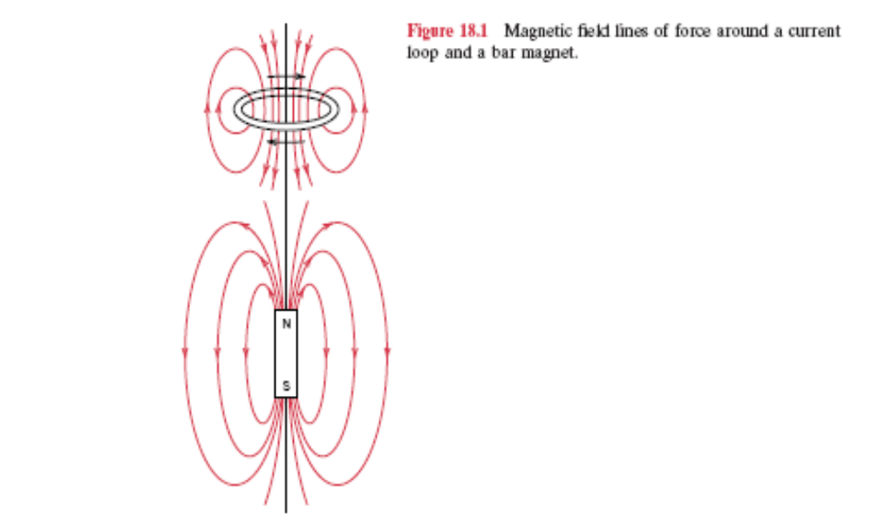
You all are familiar with magnets
And magnetic fields
But, what is it about some forms of
Matter than make them magnetic?

Slide 3
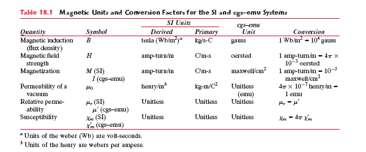
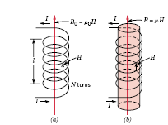
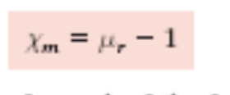
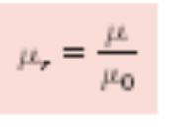
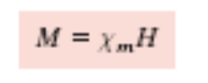
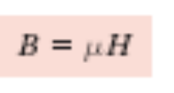
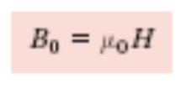
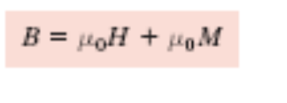
Potentially useful quantities

Slide 4
Some of those terms
Permeability - the ability of a mag field to be transferred through a material (like electrical conductivity)
Susceptibility - the ability of a material to align its dipoles to reinforce magnetization (i.e. how well a material responds to a magnetic field)

Slide 5
Magnetic properties come from electrons
Electrons have charge and spin, and generate
Their own magnetic fields
The Bohr magneton, μ_{B}, is the unit of
Magnetism of an electron; depending on spin
Up or spin down, an electron will have a
Magnetic moment of + or - μ_{B}
= 9.27 x 10⁻²⁴ A-m²

Slide 6
In completely filled shells, the spins are paired
And the magnetic moments cancel out
These filled shell material cannot be permanent
Magnets

Slide 7
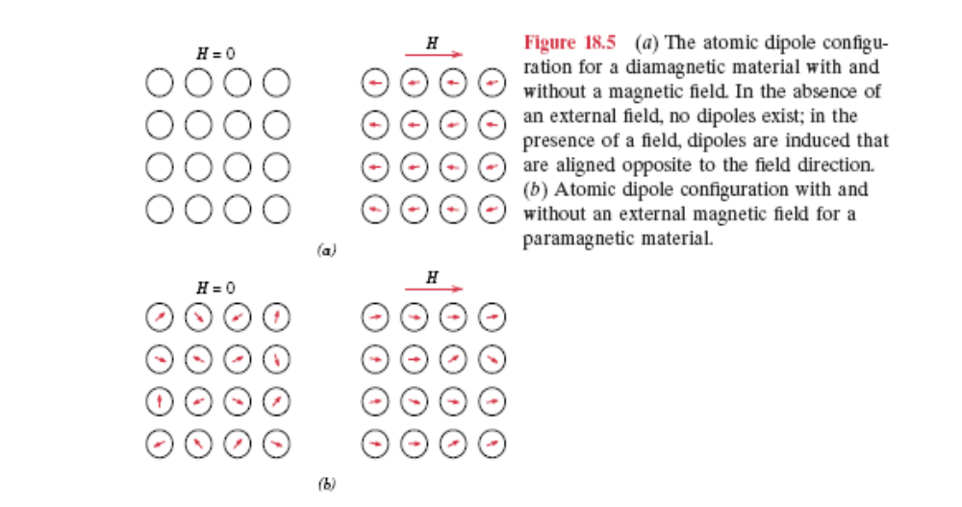
Diamagnetic materials have no
Magnetic dipoles, but can polarize
In the presence of a magnetic field
To respond weakly to that field
Paramagnetic materials do have
Unpaired electrons, but are
Disordered, and not obviously
Magnetic - they respond more
Readily to magnetic fields

Slide 8
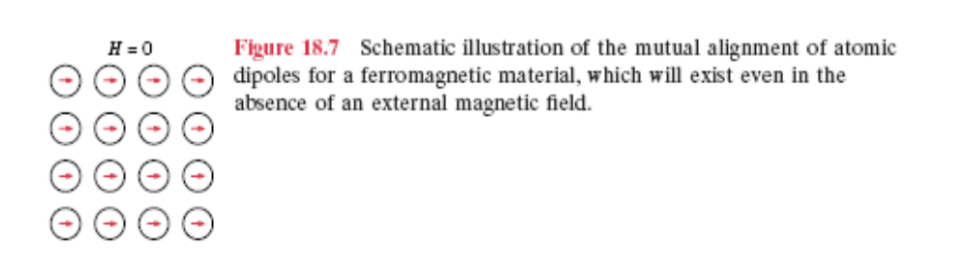
BUT, FERROMAGNETIC MATERIALS
Have permanent magnetic fields and act
Strongly magnetic
These tend to be transition metals with multiple
Unpaired electrons (remember all spins up or down!)

Slide 9
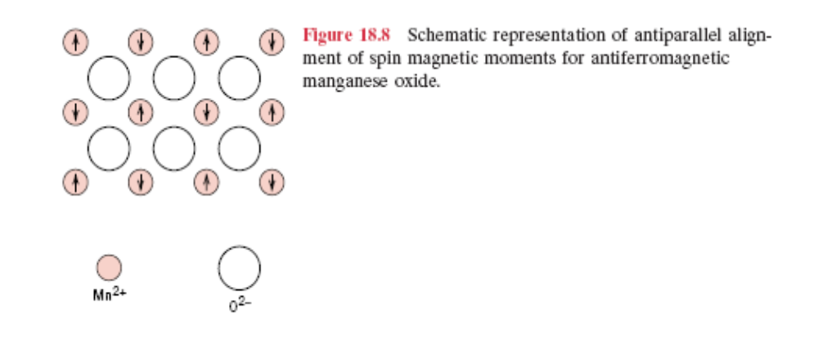
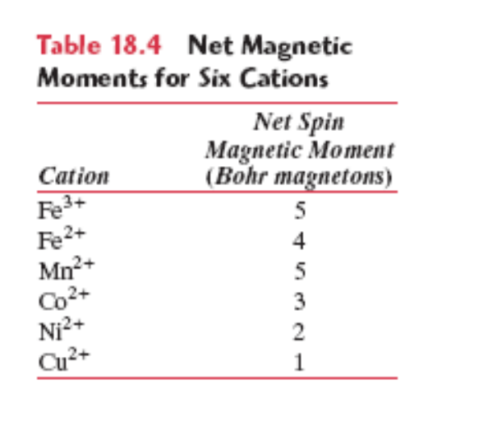
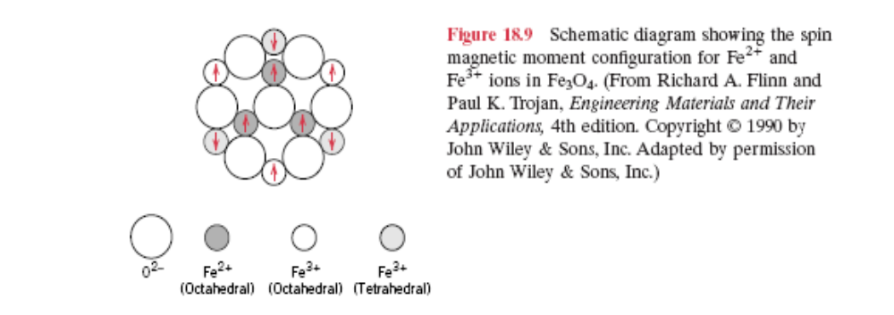
Things can be complicated!

Slide 10
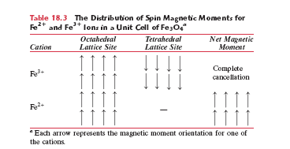
You can have mixed lattices, with partial
Cancellation, yet still possess permanent magnetic
Properties (“Lodestone”, in this case)

Slide 11
What happens as we heat up a magnetic material?
Recall what happened to electrical conductivity…
As we heated the material, lattice vibrations increased
In magnitude, decreasing the efficiency of coupling, and
Thereby decreasing electrical conductivity
Well, has we heat our magnetic material up, those
Lattice atoms again increase their vibrational motion.
This motion leads to general randomization of atomic
Positions, and randomization of electronic spin states,
Decreasing the overall magnetic properties
(susceptibility) of the material.
There is a critical temperature, the Curie Temp, at which
We lose our magnetic properties.

Slide 12
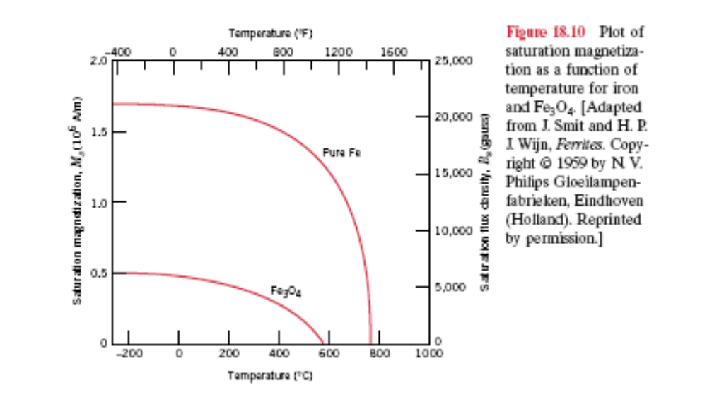

Slide 13

Note that thermal, electrical and magnetic behaviors
Behave similarly. You therefore know enough to
Answer this question…

Slide 14
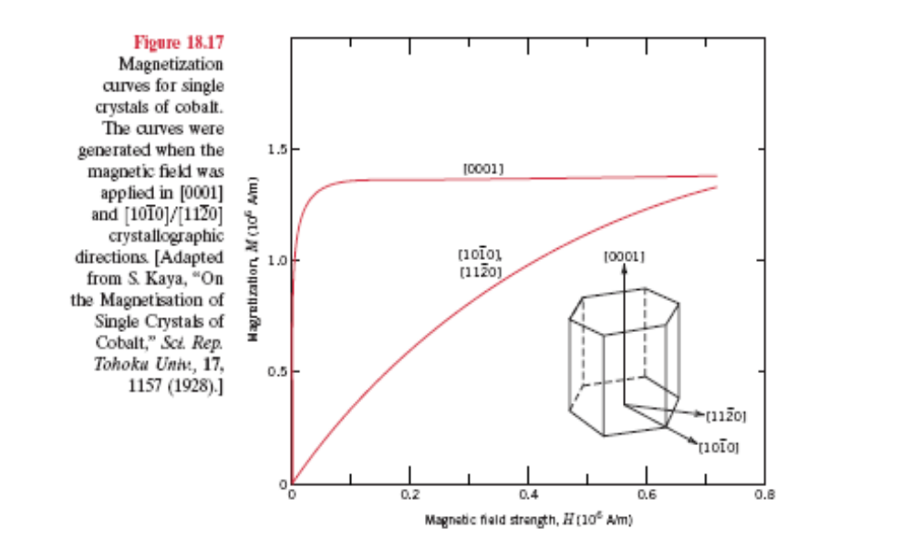
Important word: Anisotropy…not same in all
Directions.
In this case, geometry dictates magnetic directionality

Slide 15
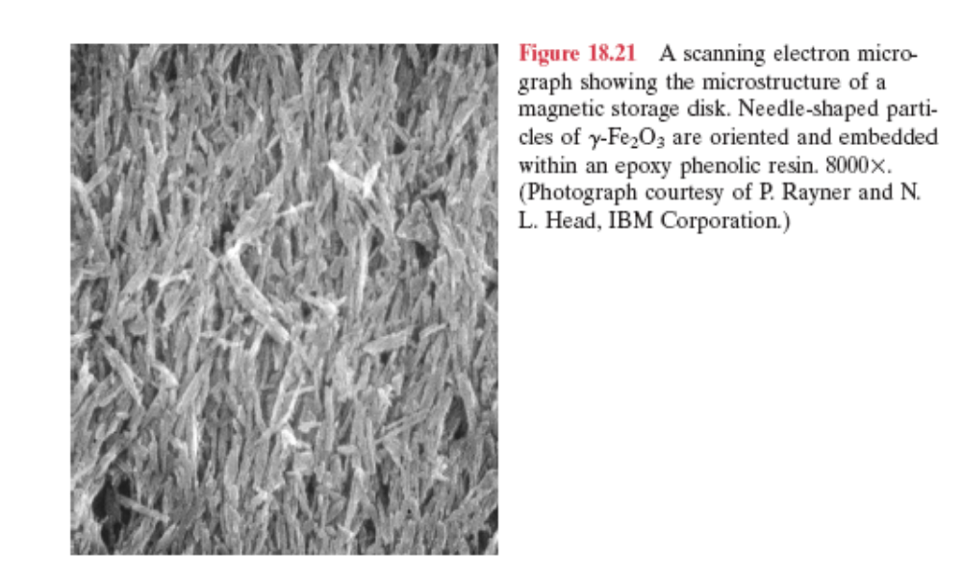
Some materials will reorganize
In response to an applied electrical
Field, allowing you to “write” on it
This is the basis of magnetic
Storage. A field “writes” electronic
Spin configurations.

Slide 16
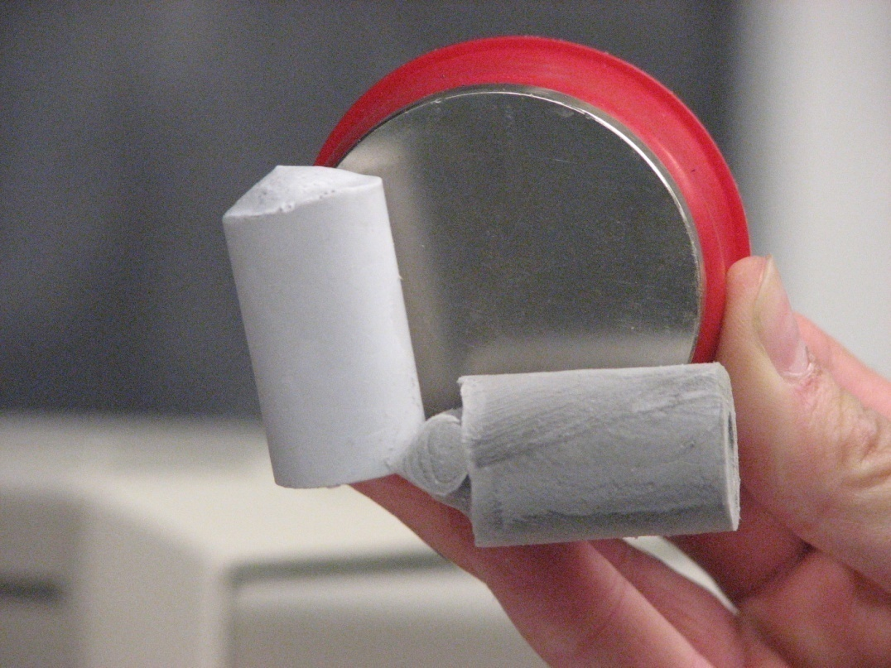
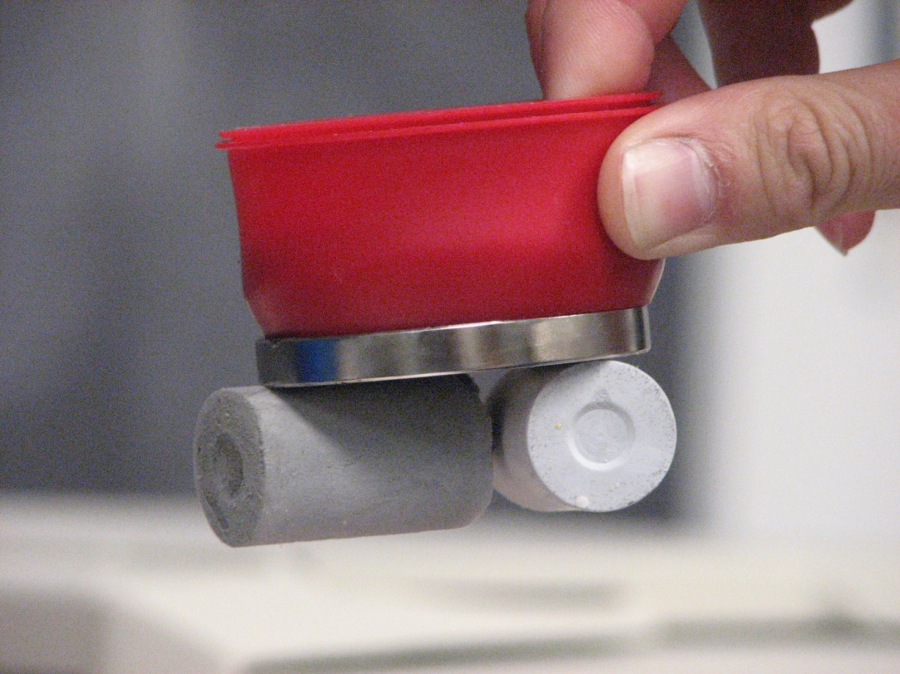
Structures on the nanoscale
Can be different than in bulk
Small metal and metal oxide
Particles can be highly
Magnetic
Schiraldi Research Group
Ni Nanoparticle/
Clay aerogel
Structures

